Slide 1





Digital Communication Systems & Digital Telecommunication TDM/PAM
Supervised By:
Dr./ Mohamed M. A. Mostafa

Slide 2
Group Participants
Ahmed Mohamed Atef 211070
Ahmed Abobakr 211072
Nagy Mohamed 211111
Gehad Abdelaziz 211118
Mohamed Abdelraheem 211130
Rawan Tarek 211131
Renad Ali 221604

Slide 3

Table of contents
03.
01.
02.
04.
05.
06.
Introduction to TDM
PAM
Block diagrams
TDM Advantages & Disadvantages
TDM Applications
CODE AND RESULTS

Slide 4


01.
Introduction To TDM

Slide 5
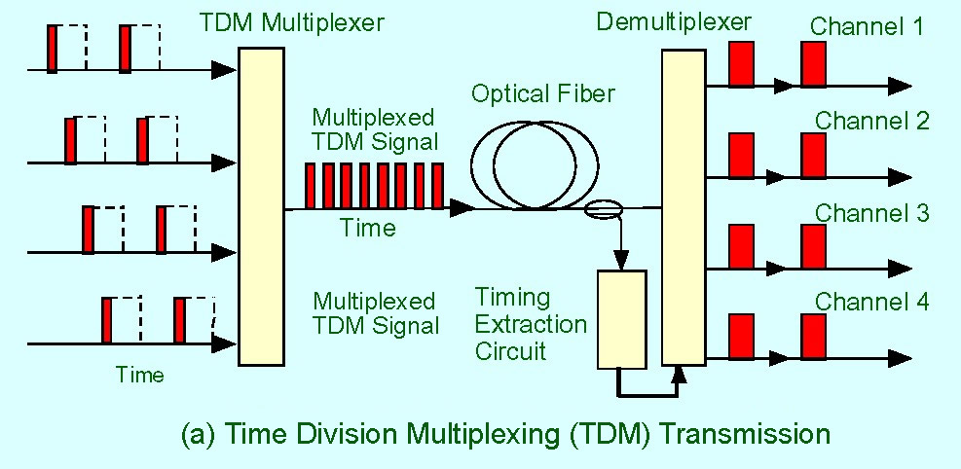
What’s TDM
TDM stands for Time Division Multiplexing.
It's a technique used to transmit multiple signals over a single communication channel.

Slide 6
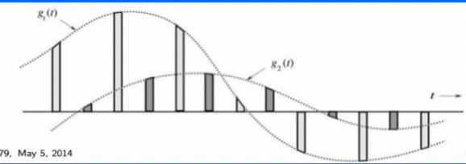
Time Division Multiplexing (TDM)
In many cases, Bandwidth of communication link is much greater than signal bandwidth
All three methods can be used with time division multiplexing (TDM) to carry multiple signals over a single channel

Slide 7
02.
PAM

Slide 8
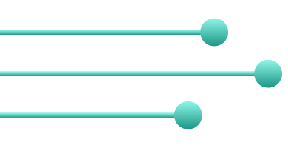
What is PAM & It’s Recovery process
A modulation technique in which the amplitude of the pulsed carrier signal is changed according to the amplitude of the message signal is known as Pulse Amplitude Modulation (PAM).

Slide 9
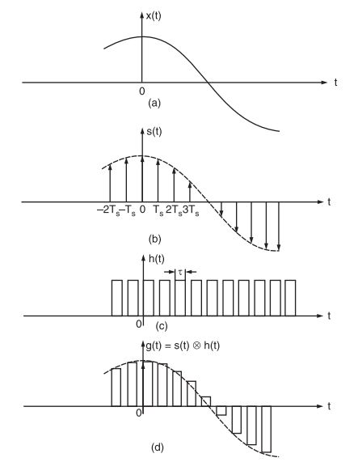
PAM Signal

Slide 10
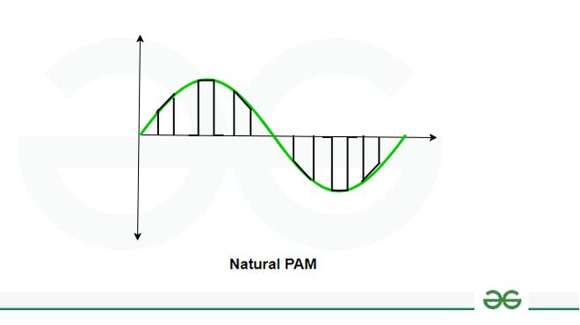
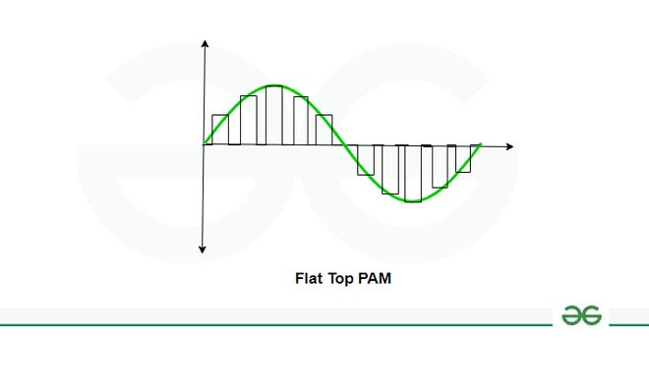
Natural PAM
Flat Top PAM

Slide 11
03.
TDM block Diagram

Slide 12
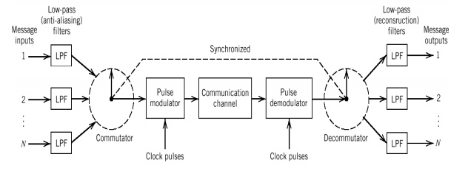
TDM block Diagram

Slide 13
04.
TDM Advantages & disadvantages

Slide 14
TDM Advantages
Simple circuit design.
Bandwidth efficiency It uses entire channel bandwidth for the transmission of the signal.
The problem of Intermodulation distortion is not present in TDM.
Pulse overlapping can sometimes cause crosstalk but it can be reduced by utilizing guard time. Thus, is not much serious.

Slide 15
TDM Disadvantages
The effort required for Synchronization The synchronization burden is substantial. To maintain adequate signal transmission and reception, the transmitter and receiver components must be correctly and consistently synced.
This technology is affected by AWGN

Slide 16
05.
TDM Applications

Slide 17
TDM Applications in Real Life
It is used in a type of telephone line that uses ISDN (Integrated Services Digital Network) technology.
It is deployed in PSTN (public switched telephone network).
It’s a significant component of a telephone system.
It’s actually found in telephone wire lines.
In a digital audio mixing system, TDM is implemented.

Slide 18
06.
CODE AND RESULTS

Slide 19
Thanks!

